Slide 1
CSCI 692: Lecture data frames and spark
Professor David Harrison

Slide 2
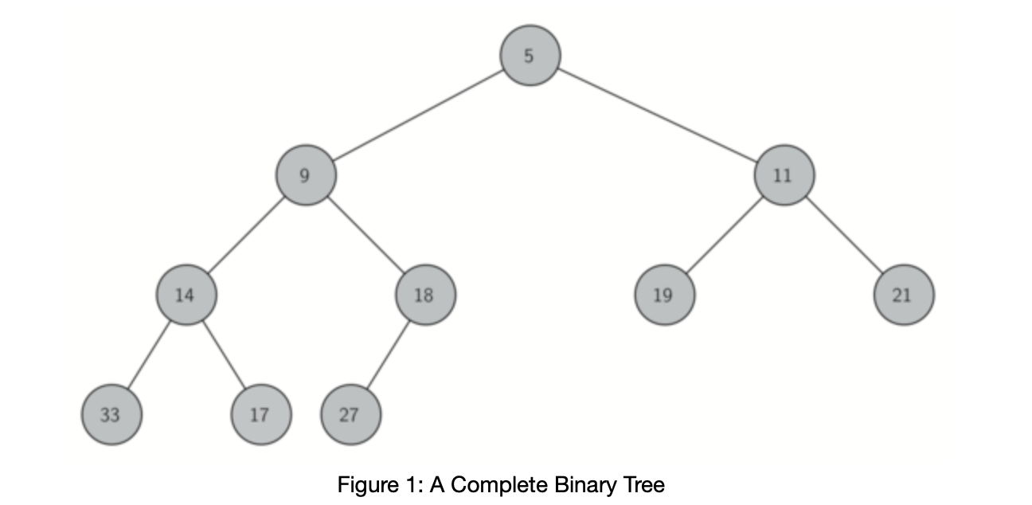
Min heap
A min-heap is a binary heap wherein the top is the smallest.
All heaps are composed of a complete tree.
Complete tree has all levels full except possibly the lowest. The lowest level may be partially full, but it is always filled from left to right.

Slide 3
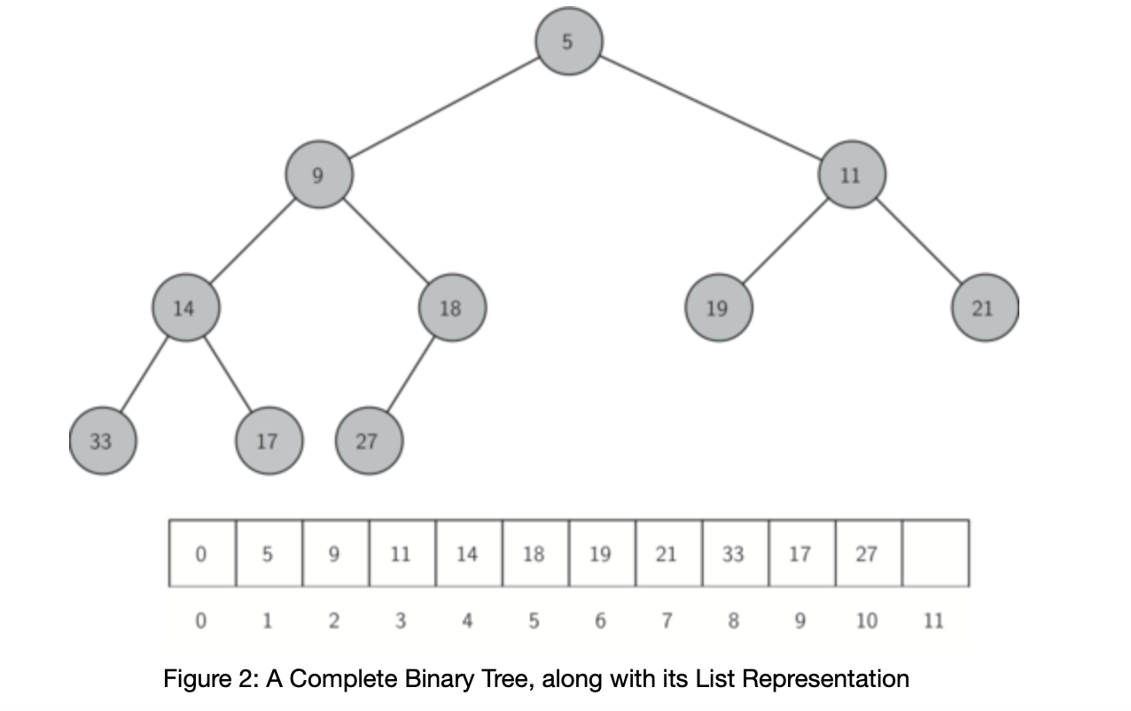
Min heap list representation
A min heap can be represented using a list or an array.
For a node at position i, its children are at indices i*2 and i*2+1.

Slide 4
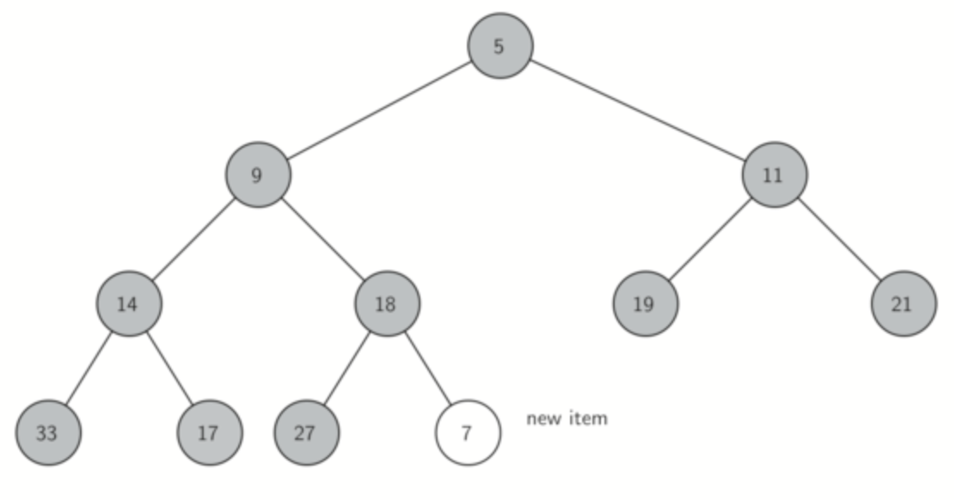
Pushing to a min heap
Push to the bottom and percolate it up to the right position

Slide 5
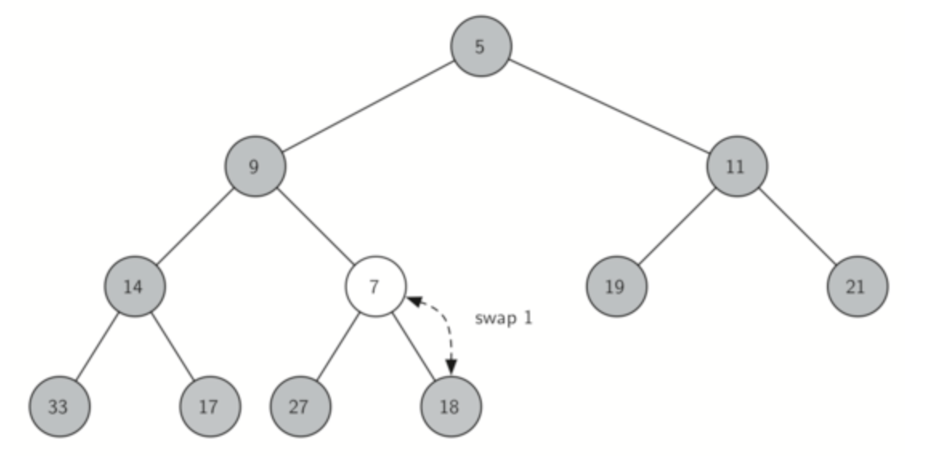
Pushing to a min heap
Push to the bottom and percolate it up to the right position

Slide 6
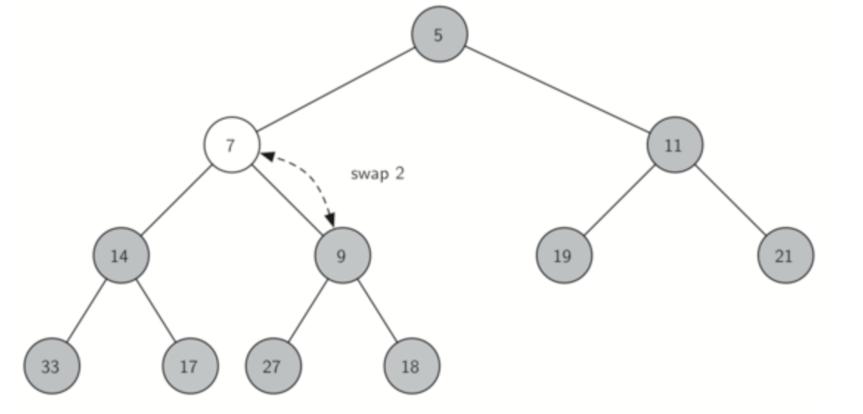
Pushing to a min heap
Push to the bottom and percolate it up to the right position

Slide 7
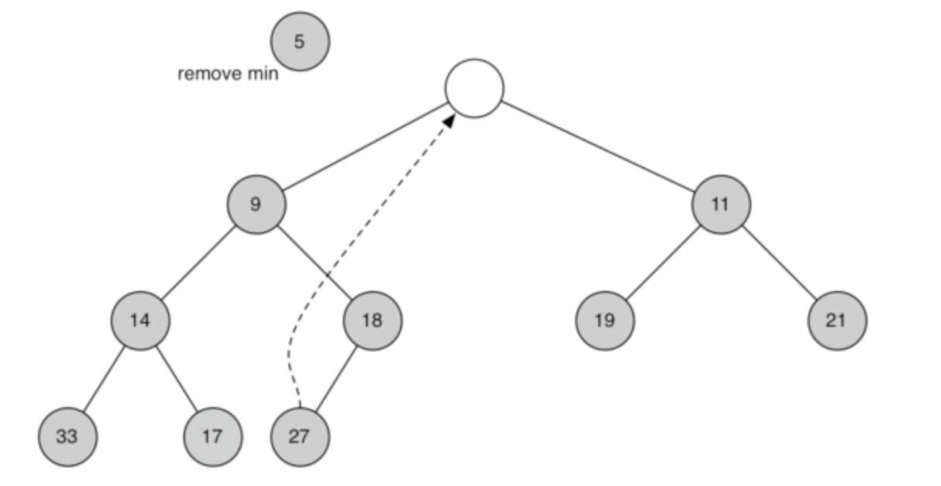
Popping from min heap
Remove top. Move rightmost node in bottom level to the root and percolate it downward.

Slide 8
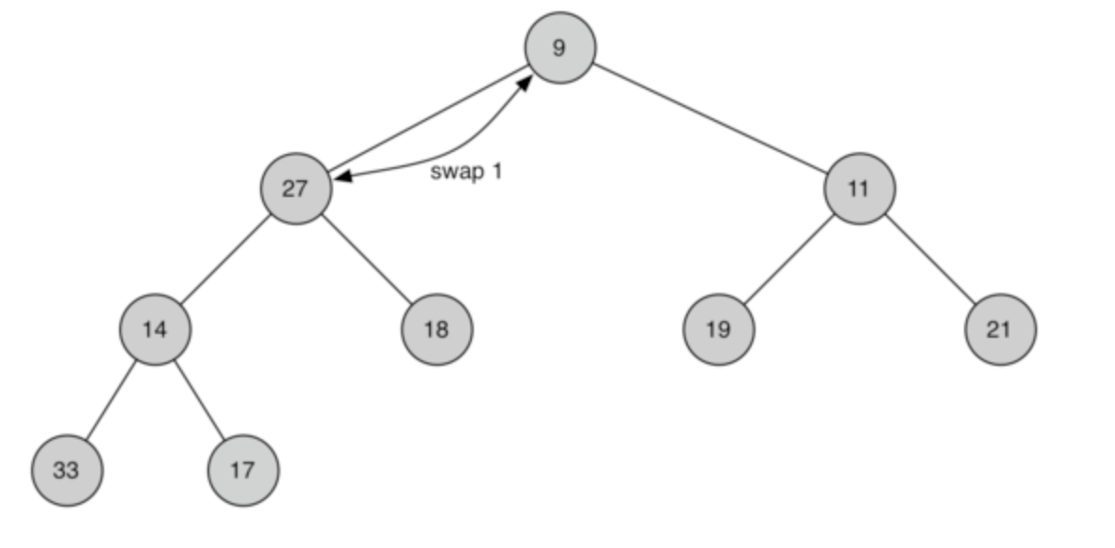
Popping from min heap
Remove top. Move rightmost node in bottom level to the root and percolate it downward.

Slide 9
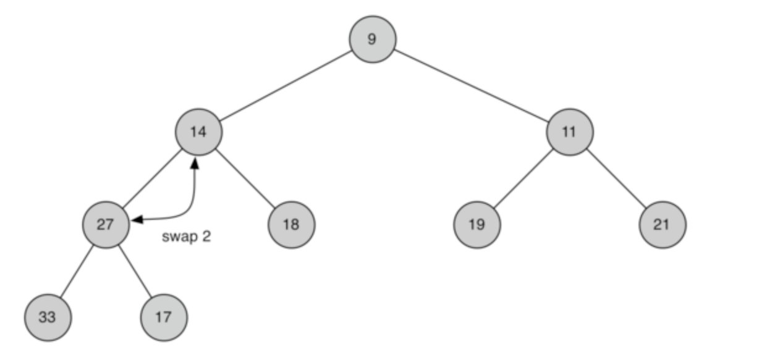
Popping from min heap
Remove top. Move rightmost node in bottom level to the root and percolate it downward.

Slide 10
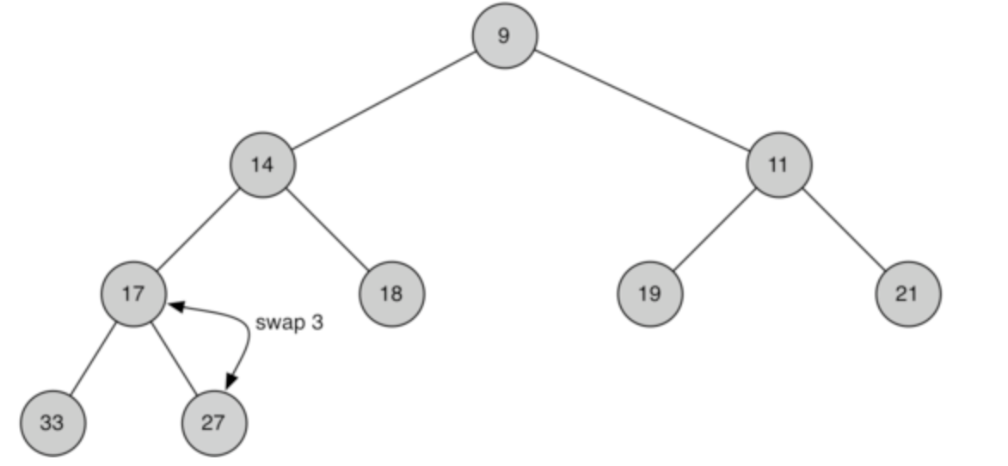
Popping from min heap
Remove top. Move rightmost node in bottom level to the root and percolate it downward.

Slide 11
Priority queue
A priority queue is a queue except that it always returns the key with the highest priority.
For a min heap, the highest priority is represented with the minimum key.
All pops and pushes to the priority queue take O(log n).

Slide 12
Binary heap operations
A priority queue is a queue except that it always returns the key with the highest priority.
For a min heap, the highest priority is represented with the minimum key.
All pops and pushes to the priority queue take O(log n).

Slide 13
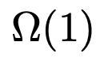
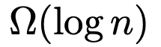
Binary heap operations
Name | Big-O | Big-Omega (distinct) | Big-Omega (not distinct)
Push heap
Pop heap
Distinct → all nodes have distinct values.
Not distinct → duplicate values allowed in the heap
For “not distinct” case think all values are the same. No percolate up or down needed to retain heap ordering.

Slide 14
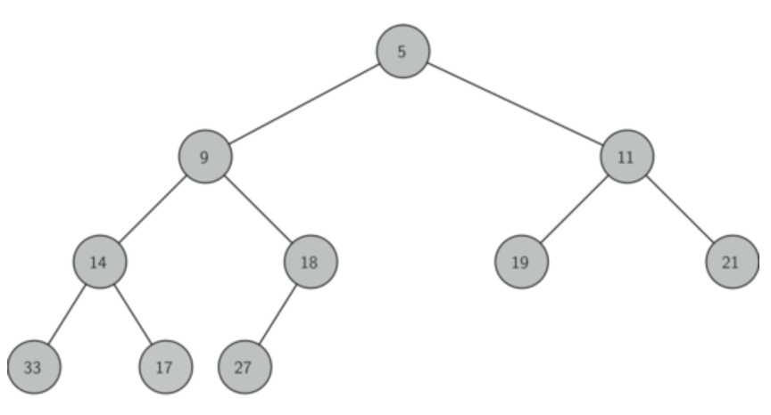
Priority queue
Heaps are often used to implement a priority queue.
Highest priority are at the top.
If lower number means higher priority then use a min heap.
Priority queue as heap
5
9
11
14
17
18
19
21
27
33
Pop heap
Logical representation of priority queue
Push heap

Slide 15
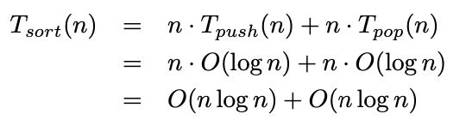
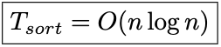
Heap sort
Every pop removes the smallest.
Sort by pushing everything into a min heap and then popping them one at a time.
What is the cost of pushing n and popping n?

Slide 16
Make heap
But can we create a heap faster than O(n log n)?
Built it from the bottom up.
18
9
19
14
5
11
21

Slide 17
Make heap
But can we create a heap faster than O(n log n)?
Built it from the bottom up.
18
9
11
14
5
19
21

Slide 18
Make heap
But can we create a heap faster than O(n log n)?
Built it from the bottom up.
18
5
11
14
9
19
21

Slide 19
Make heap
But can we create a heap faster than O(n log n)?
Built it from the bottom up.
5
18
11
14
9
19
21

Slide 20
Make heap
But can we create a heap faster than O(n log n)?
Built it from the bottom up.
5
9
11
14
18
19
21

Slide 21
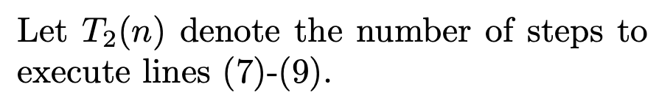
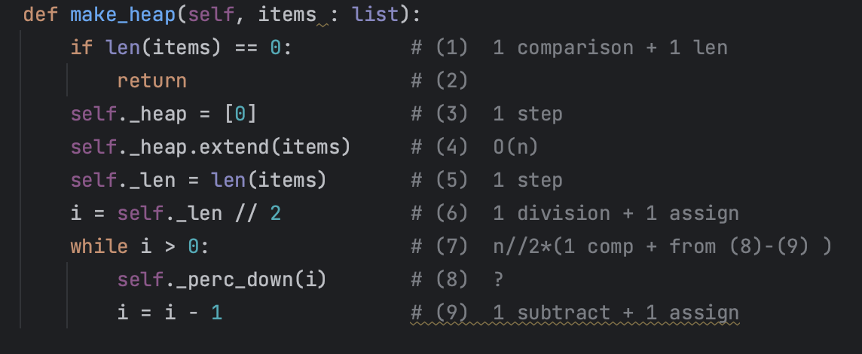
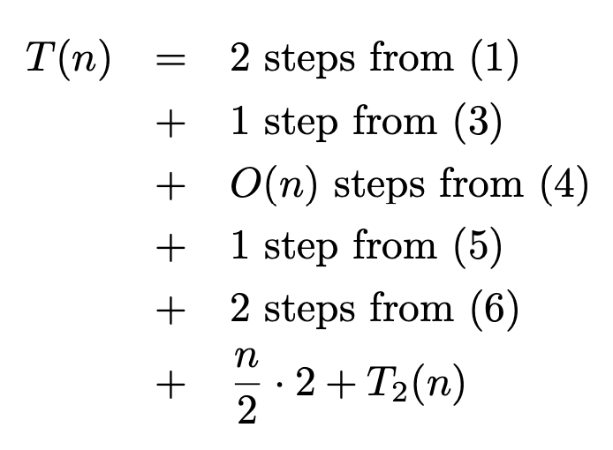
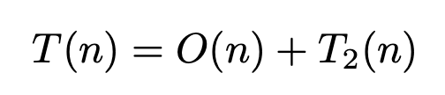
Make heap
But can we create a heap faster than O(n log n)?

Slide 22
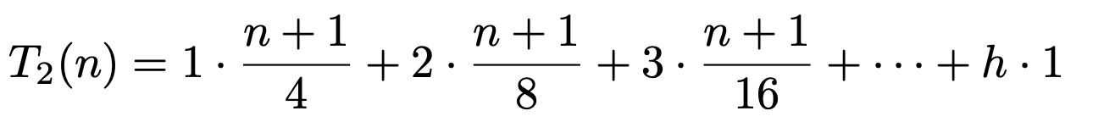
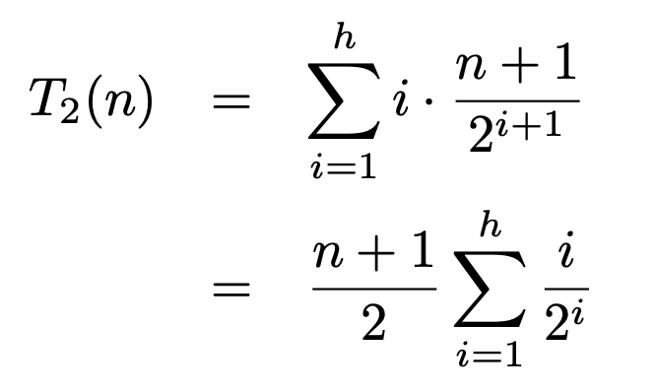
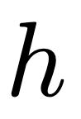
Make heap
But can we create a heap faster than O(n log n)?
18
9
19
14
5
11
21

Slide 23
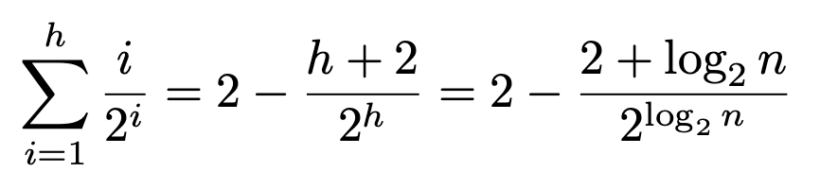
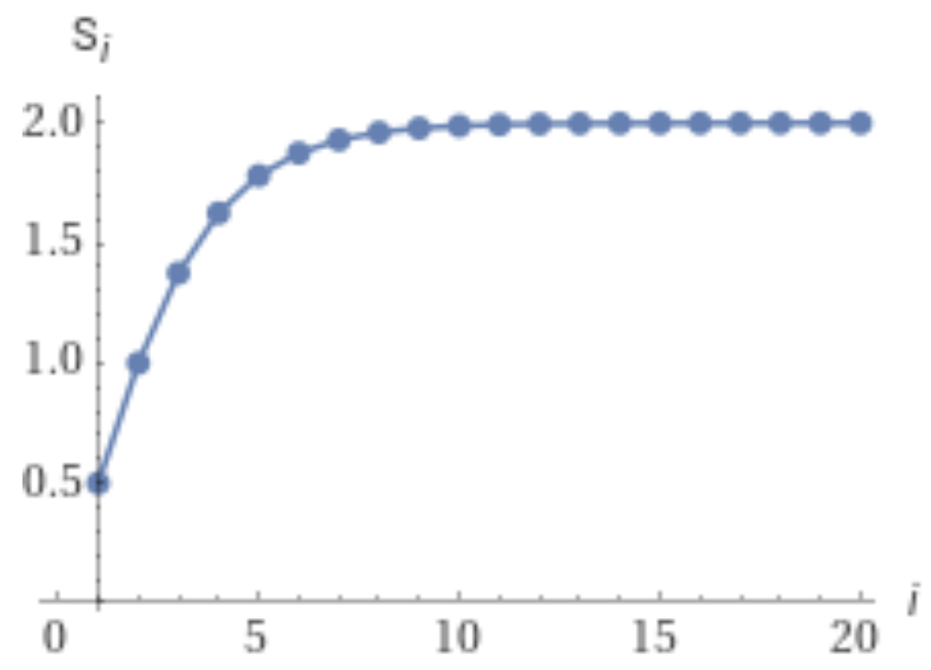
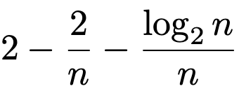
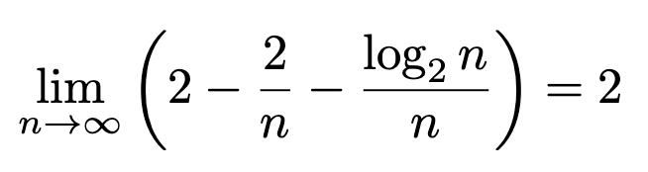
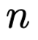
Make heap
But can we create a heap faster than O(n log n)?
Sum

Slide 24
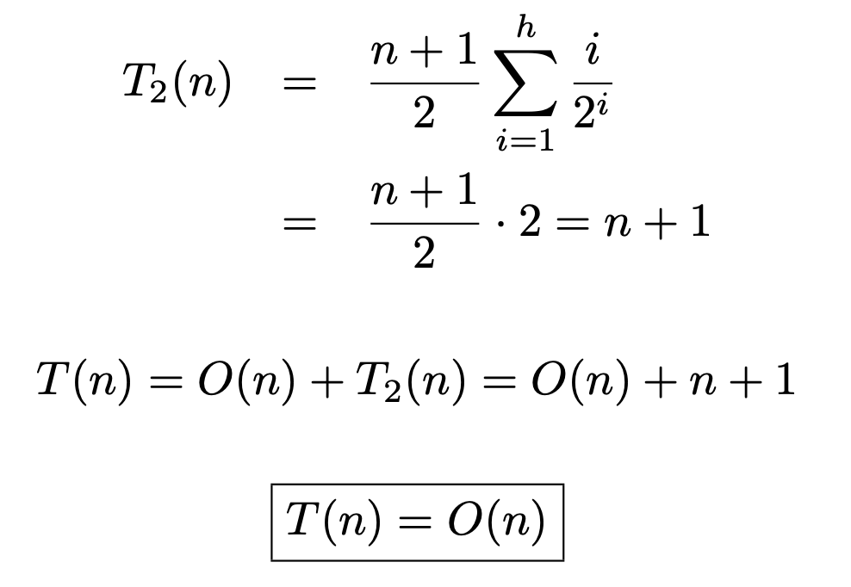
Make heap
But can we create a heap faster than O(n log n)?
18
9
19
14
5
11
21

Slide 25
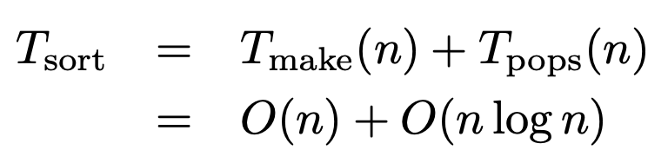
Heap sort using make heap
Use make heap to establish heap ordering.
Then pop all n elements from the heap starting from smallest.
What is the cost of make heap on n and popping n?
Using make heap doesn’t improve big-O for sort. But make_heap is still useful when creating a priority queue.

Slide 26
Sorting using Make heap versus pushing
.
All pushes and pops
make_heap and pops

Slide 27
Heap sort vs quick sort
.
All pushes and pops
make_heaps
quick_sort

Slide 28
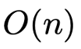
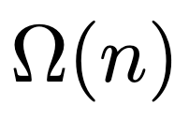
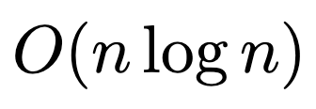
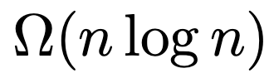
Binary heap operations
Name | Big-O | Big-Omega (distinct) | Big-Omega (not distinct)
Push heap
Pop heap
Make heap
Heap sort
.

Slide 29
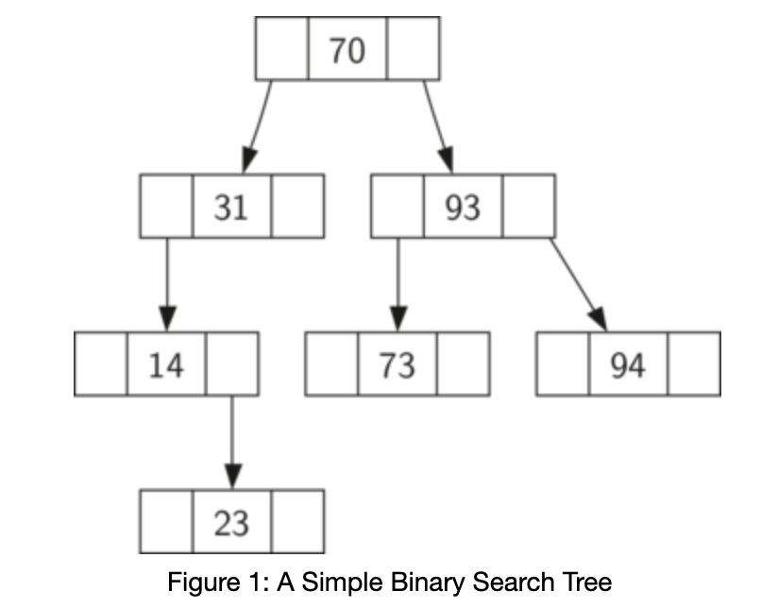
Binary search tree
.

Slide 30
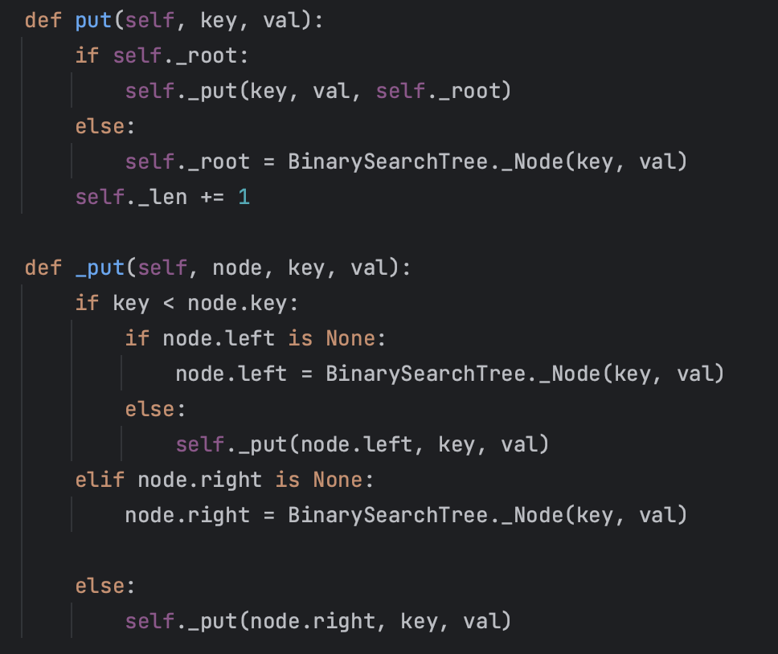
Binary search tree: put
.

Slide 31
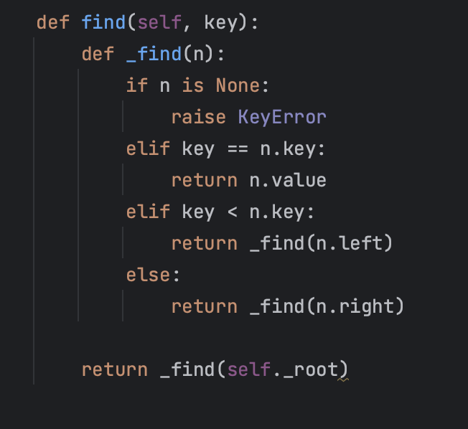
Binary search tree：find
.

Slide 32
Binary search tree：find
.

Slide 33
Binary search tree：find
.
1
2
5
7
12

Slide 34
THANK YOU
David Harrison
Harrison@cs.olemiss.edu

